Slide 1
It takes hours of preparation For each minute of presentation time

Slide 2
A very warm healthy good morning to each one of you present here .
My name is Unnati Joshi. I am very grateful to our IT teacher for giving me a chance to present myself in front of the class.
I am here to present my swot analysis but before beginning it let’s understand the importance of SWOT analysis.
It is important as it helps us achieving clear picture of where we stand and secondly to understand areas of improvement.

Slide 3
Swot stands for
S- Strengths 💪
W - weakness 🌈
O – Opportunities 💫
T –threats 🌻

Slide 4

Strength 💪

Slide 5
My strengths are as follows:
I am good at story writing.
I am good at organizing things.
I try to put all my efforts in anything I do.
I am self motivated.
I do not vacillate.
I am a self Reliance person

Slide 6
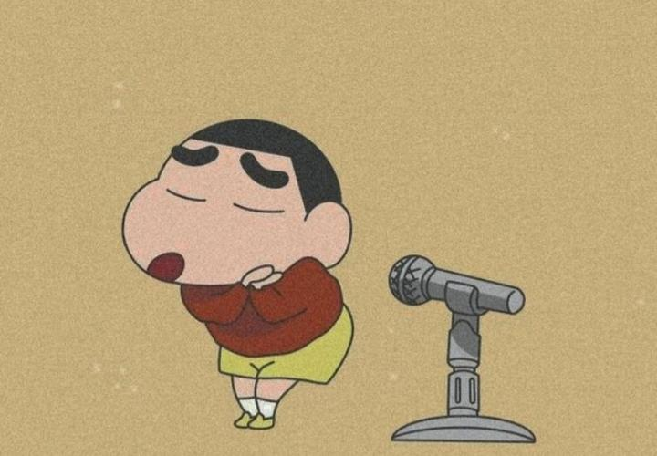
Weaknesses 🙃

Slide 7
My weaknesses are as follows
I am a very lazy person and I require a lot of courage to complete my work.
I am not a morning person.
I am a very impatient person.
Iget distracted easily.
I often do not accept my mistakes.
I believe a lot in superstition.

Slide 8

Opportunities

Slide 9
My opportunities are as follows
I have got many prizes for story writing competitions.
I have got prizes for English debate competitions and many English speech competitions.
I have won medals for running competitions and various broad jumping competitions.

Slide 10
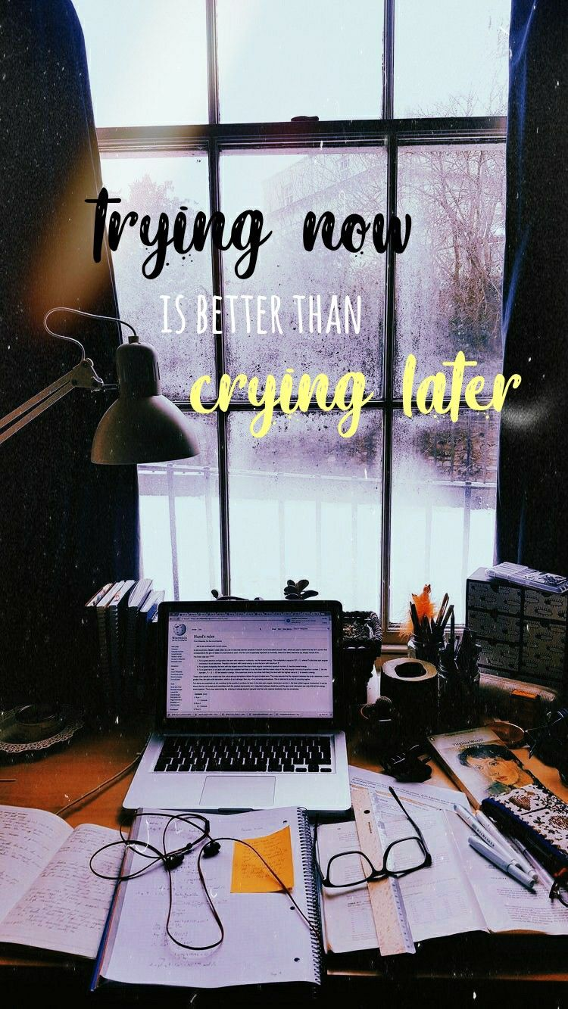
Threats

Slide 11
My threats are as follows
I am trying to work on my patience level by meditating daily . 🧘‍♀️
l am working on my stubborn habits and will leave it as soon as possible.
I will be accepting my mistakes and I am sure that I will leave this habit as early as I can.
I am not a morning person as I told in my weakness also but I’m trying to wake up early in the morning daily and this will become my strength soon .

Slide 12

Thank you all for listening to me hope you enjoyed my presentation….!!

